Slide 1
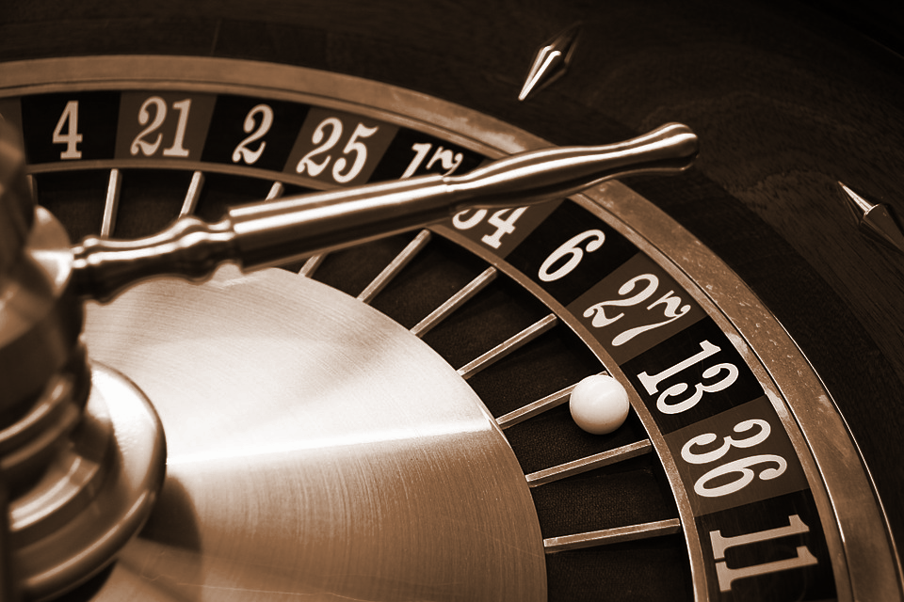
Ocean’s Five
Working with nested sequences and lists

Slide 2
The Mission:
You and your pair programming partner are plotting your biggest heist yet. You’ll need to assemble a crack team of experts to pull it off.

Slide 3
The Team:
Begin by entering you and your partner’s information in rows 1 and 2 of your sheet:
NAME | - Enter your real first name.
ALIAS | - Enter an alias that is a one-word food item.
SPECIALTY | - Randomly choose a number, 1 - 4.
MOLE | - Randomly choose a number, 1 - 4.

Slide 4
The Team:
You will need to recruit the best talent available if you are going to pull this heist off...
Recruit 3 additional team members to join your plot. Write down their information on your chart. These teammates could be real or made up.

Slide 5
#1. Nested Sequence:
Create a nested sequence to hold your your team’s information. Each team member's info is a list nested in one big list. Submit your repl.it url here when done.
Notes:
🍐 This is a Pear Deck Text Slide
🍐 To edit the type of question, go back to the "Ask Students a Question" in the Pear Deck sidebar.

Slide 6
import random
# create nested sequence with your team; each member's info is a list nested in one big list
theFive = [
["Danny Ocean", "potato", 4, 1],
["Basher Tarr", "banana", 4, 2],
["Linus Caldwell", "taco", 3, 3],
["Reuben Tishkoff", "fish", 2, 4],
["Tess Ocean", "salad", 1, 5]
]
print(theFive)
print()

Slide 7
#2. A Good Alias?:
Partner Switch
For this heist, a good alias must contain the letter ‘A’ in order to be effective. The placement and number of A’s in an alias will help communicate secret information amongst your team.
Loop through your team list and check to see if each alias contains the letter A. If it does, print a message telling the user which person has a good alias. If not, randomly reassign a good alias.
Notes:
🍐 This is a Pear Deck Multiple Choice Slide. Your current options are: A: We got it. Moving on to the next one., B: We think we got it. Moving on to the next one., C: We are stuck and need help.,
🍐 To edit the type of question or choices, go back to the "Ask Students a Question" in the Pear Deck sidebar.

Slide 8
# loop and test to see if each alias has an "A";
# print a message saying the name of each member with a # good alias randomly assign a good alias if the alias does # not have an A
for agent in theFive:
if "a" in agent[1].lower():
print(agent[0], "has a good alias")
else:
agent[1] = random.choice(("orange", "pasta", "tomato", "beans", "steak"))
print()
print(theFive)

Slide 9

#3. Find the moles:
Partner Switch
There is always a risk of your team
being infiltrated by a mole.
Loop through your team list and check to see if you have any moles in your ranks. A mole will have the number 3 in the last element of their list. Delete any moles from your team using the .pop() list method.
Notes:
🍐 This is a Pear Deck Multiple Choice Slide. Your current options are: A: We got it. Moving on to the next one., B: We think we got it. Moving on to the next one., C: We are stuck and need help.,
🍐 To edit the type of question or choices, go back to the "Ask Students a Question" in the Pear Deck sidebar.

Slide 10
# loop and test to see if each alias has an "A";
# print a message saying the name of each member with a # good alias randomly assign a good alias if the alias does # not have an A
counter = 0
for agent in theFive:
if agent[3] == 3:
mole = theFive.pop(counter)
print("\n" + mole[3], "is a mole and has been removed from the team")
counter += 1
print()
print(theFive)

Slide 11
#4. Replace the moles:
Partner Switch
You will need to recruit new team
members to replace any moles you
may have found. Add enough members
to your team chart to complete your five.
Use the .append() list method to add these new members onto your big list.
Notes:
🍐 This is a Pear Deck Multiple Choice Slide. Your current options are: A: We got it. Moving on to the next one., B: We think we got it. Moving on to the next one., C: We are stuck and need help.,
🍐 To edit the type of question or choices, go back to the "Ask Students a Question" in the Pear Deck sidebar.

Slide 12
# replace any moles you deleted by appending new members
theFive.append(["Isabel Lahiri", "Quesadilla", 3, 1])
print(theFive[-1][0], "has been added to the team to replace a mole.")
print()
print(theFive)
print()

Slide 13
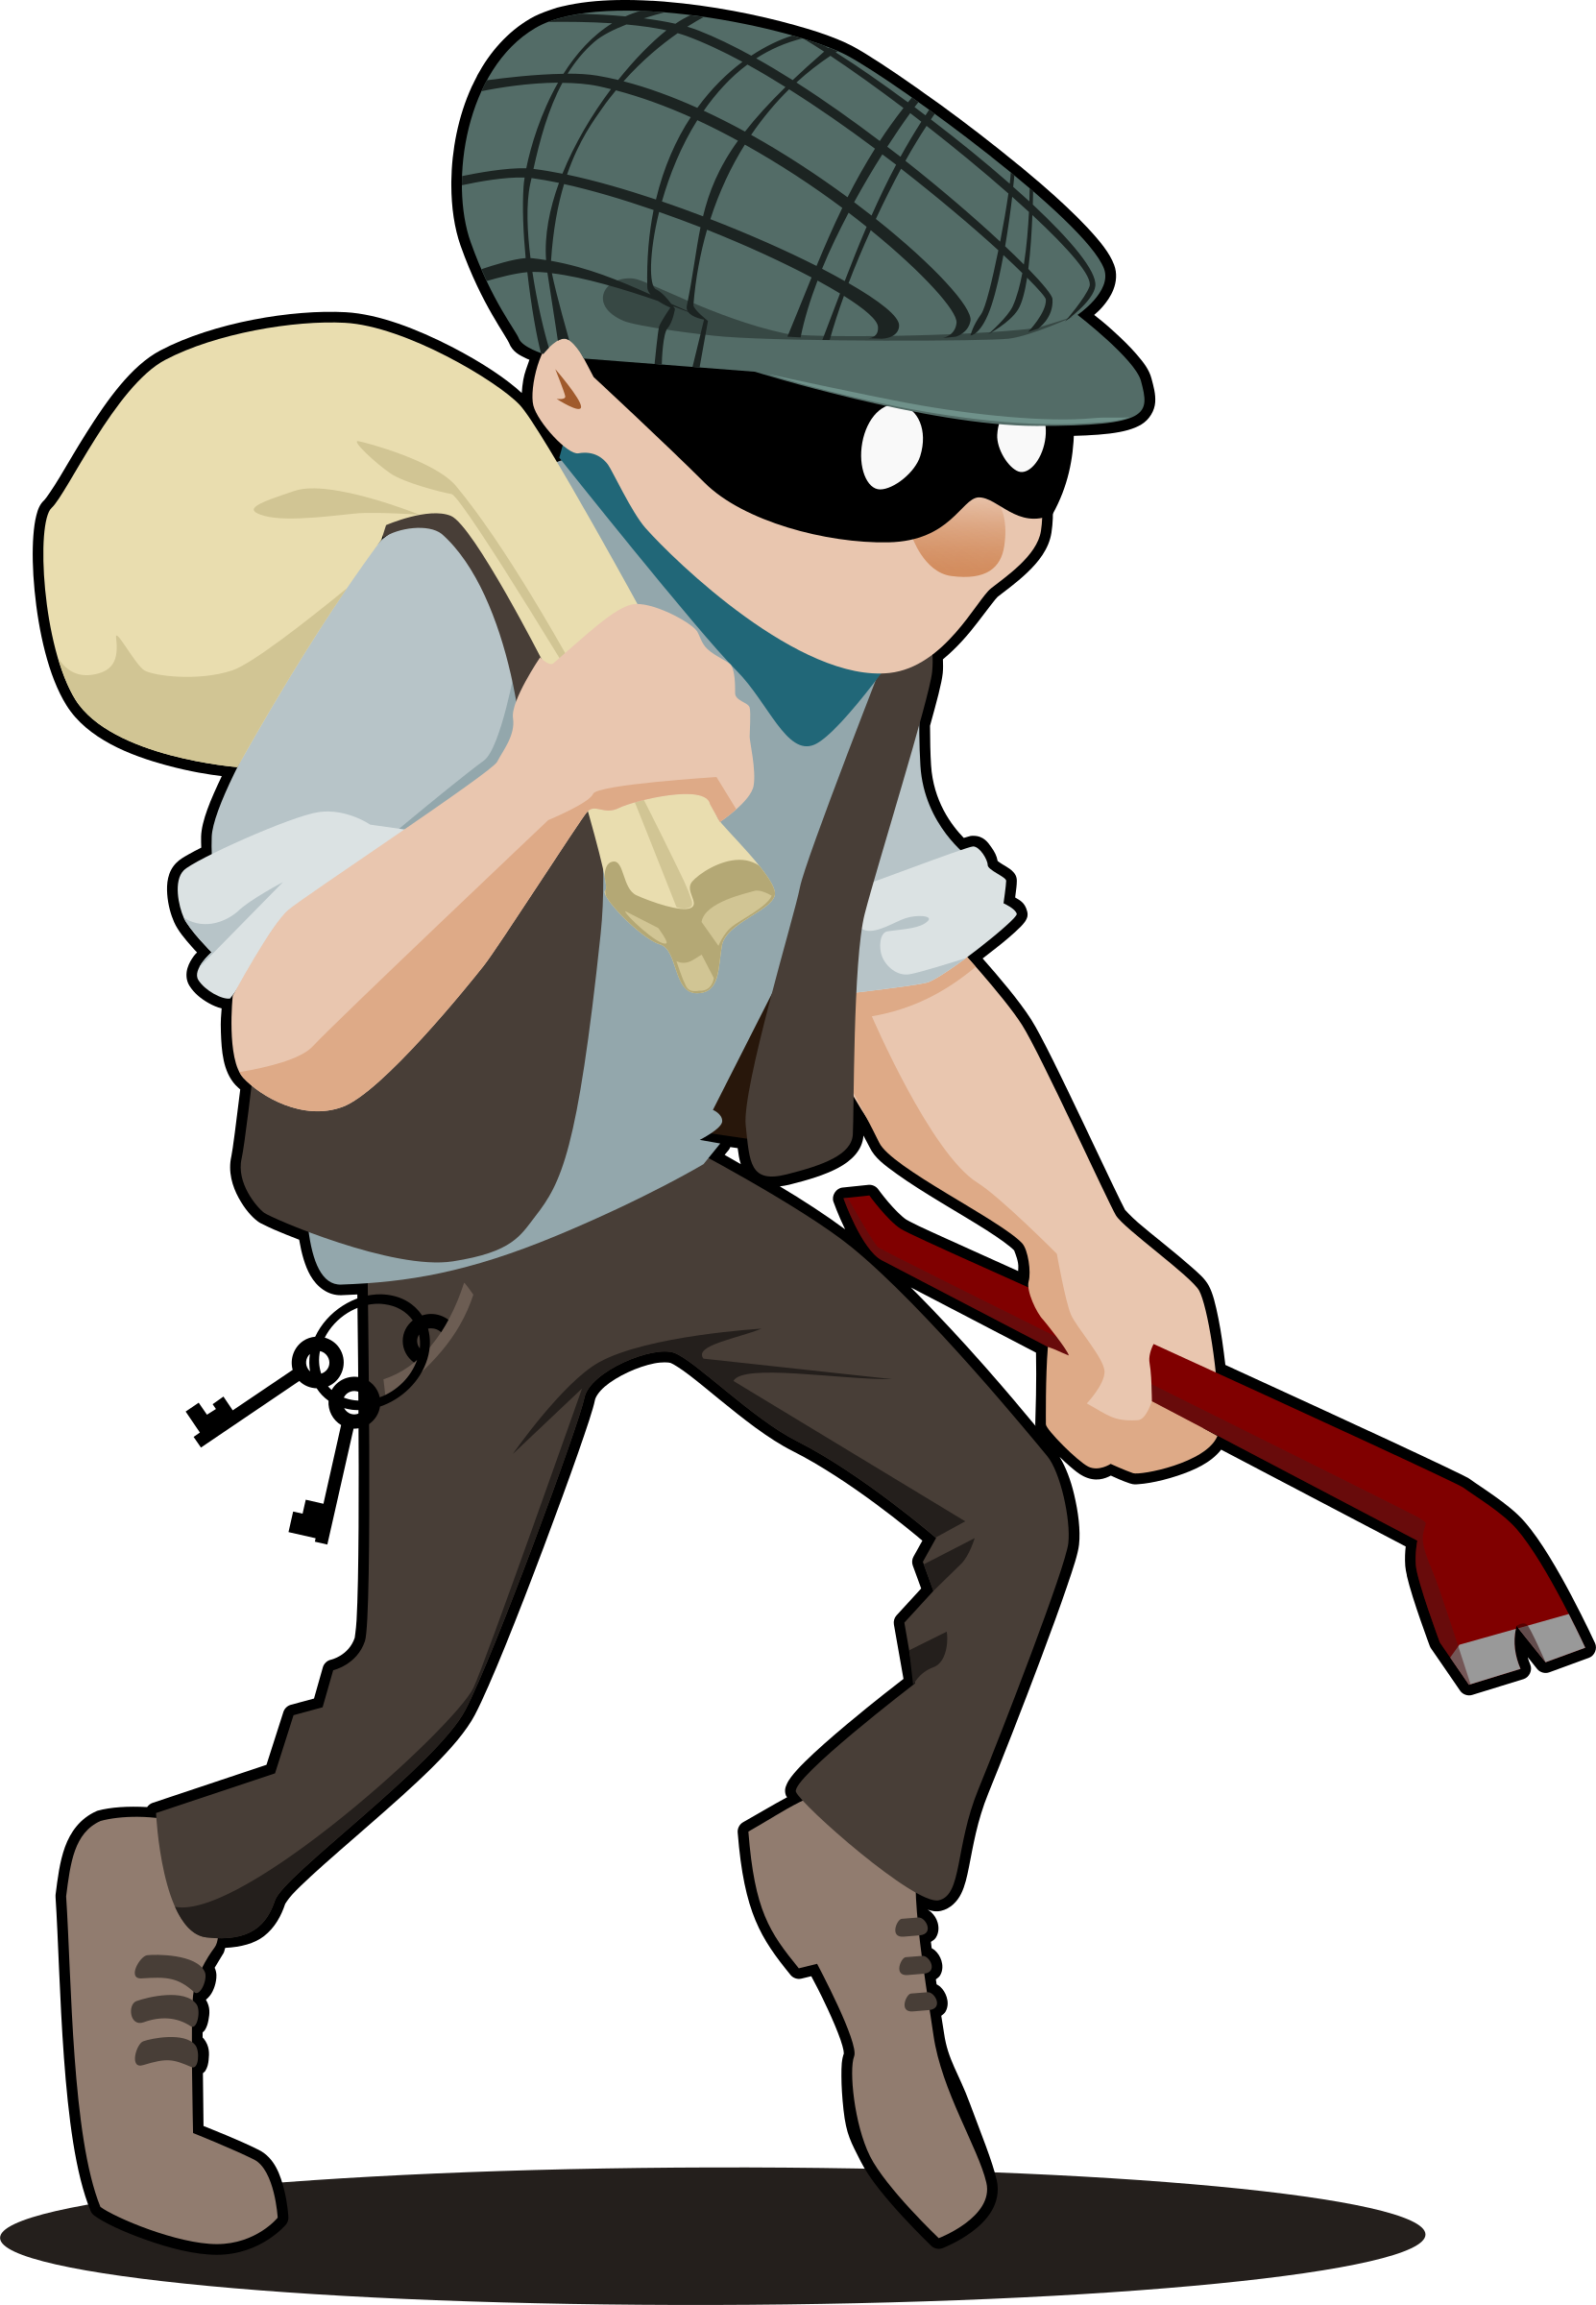
#5. The Ultimate Team:
Partner Switch
The ultimate heist team will have a diversified team of specialists. Ideally you want one of each:
Ringleader
Driver
Safe-cracker
Tech genius

Slide 14
#5. The Ultimate Team:
Loop through your team list and check to see if you have one of each specialty.
If you do, print a message saying that you have a good mix of specialties.
If not, print a message saying how many specialties you are missing.
Notes:
🍐 This is a Pear Deck Multiple Choice Slide. Your current options are: A: We got it. Moving on to the next one., B: We think we got it. Moving on to the next one., C: We are stuck and need help.,
🍐 To edit the type of question or choices, go back to the "Ask Students a Question" in the Pear Deck sidebar.

Slide 15
# check to see if your team has one of each specialty
specs = [1, 2, 3, 4, 5] # list of each specialty number
for agent in theFive:
if agent[2] in specs:
specs.pop(specs.index(agent[2])) # remove specialty from specs list if in team
# check strength of team
if len(specs) == 0: # if no specialties left, all were found
print("Your five have a good mix of specialties.")
elif len(specs) == 1:
print("Your five are missing one specialty.")
else:
print("Your five are missing", len(specs), "specialties")

Slide 16
Ocean’s Five Self-Assess
Take the Canvas self-assess quiz to tell me about your progress towards achieving the targets today.
Target: I will be able to create nested sequences.
I will be able to access nested sequences.
I am lost and need help.
I am starting to get it but need more instruction.
I get it but could use more practice.
I know it so well I could teach it.
Notes:
🍐 This is a Pear Deck Multiple Choice Slide. Your current options are: A: 1, B: 2, C: 3, D: 4,
🍐 To edit the type of question or choices, go back to the "Ask Students a Question" in the Pear Deck sidebar.

